Slide 1


Slide 2
Examples’ Source Code
Source Code for examples presented in these slides can be found on:
Blackboard->Course Content->Source Code Of The Book Examples

Slide 3
Module 17 Topics
10.9 Interfaces
Polymorphism with Interfaces
UML diagrams – interfaces

Slide 4
Interfaces
An interface is similar to an abstract class that has all abstract methods.
It cannot be instantiated, and
all of the methods listed in an interface must be written elsewhere.
The purpose of an interface is to specify behavior for other classes.
An interface looks similar to a class, except:
the keyword interface is used instead of the keyword class, and
the methods that are specified in an interface have no bodies, only headers that are terminated by semicolons.

Slide 5
Interfaces
The general format of an interface definition:
public interface InterfaceName
{
(Method headers...)
}
All methods specified by an interface are public by default.
A class can implement one or more interfaces.

Slide 6
Interfaces
If a class implements an interface, it uses the implements keyword in the class header.
public class FinalExam3 extends GradedActivity implements Relatable
Example:
GradedActivity.java
Relatable.java
FinalExam3.java
InterfaceDemo.java

Slide 7
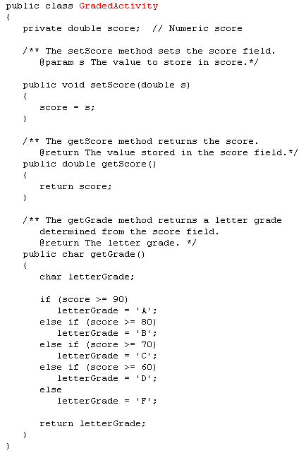
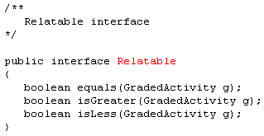

Slide 8
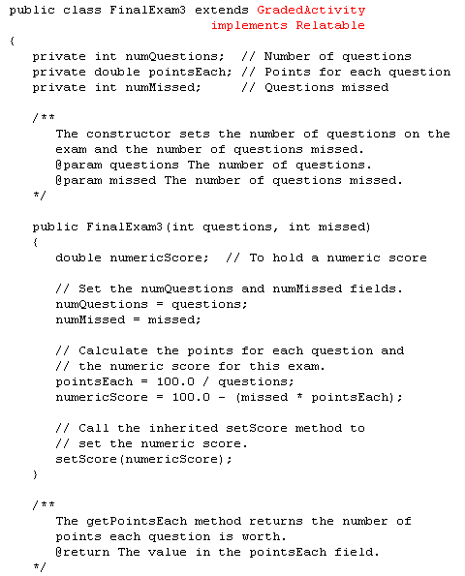
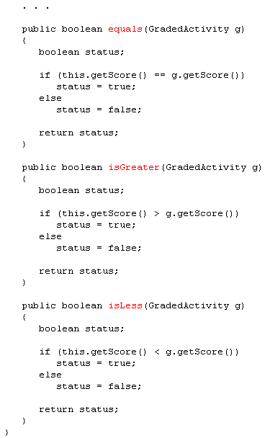

Slide 9
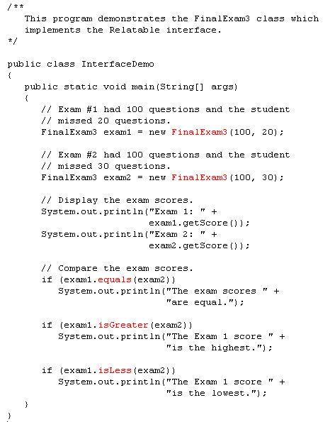

Slide 10
Fields in Interfaces
An interface can contain field declarations:
all fields in an interface are treated as final and static.
Because they automatically become final, you must provide an initialization value.
public interface Doable
{
int FIELD1 = 1, FIELD2 = 2;
(Method headers...)
}
In this interface, FIELD1 and FIELD2 are final static int variables.
Any class that implements this interface has access to these variables.

Slide 11
Implementing Multiple Interfaces
A class can be derived from only one superclass.
Java allows a class to implement multiple interfaces.
When a class implements multiple interfaces, it must provide the methods specified by all of them.
To specify multiple interfaces in a class definition, simply list the names of the interfaces, separated by commas, after the implements key word.
public class MyClass implements Interface1,
Interface2,
Interface3

Slide 12
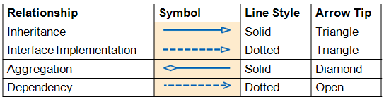
Interfaces in UML
GradedActivity
A dashed line with an arrow indicates implementation of an interface.
FinalExam3
Relatable

Slide 13
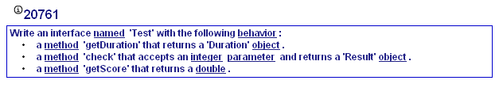
My Programming Lab 9 – 10.9

Slide 14
Assume the existence of an interface, EventHandler, with the following method : handle: void-returning, accepts a parameter of type ActionEvent (does this sound familiar?)
Define a class , GUIApplication, that implements the above interface and has the following members: - an instance variable , doc, of type Document - a constructor that accepts a Document parameter used to initialize the instance variable - an implementation of the handle method that invokes the Document method , “save”, with the document instance variable and sends the message "document saved" to System.out
public class GUIApplication implements EventHandler<ActionEvent> {
private Document doc;
public GUIApplication(Document doc)
{this.doc = doc;}
public void handle(ActionEvent event) {
doc.save();
System.out.println("document saved");
}
}

Slide 15
Polymorphism with Interfaces
Java allows you to create reference variables of an interface type.
An interface reference variable can reference any object that implements that interface, regardless of its class type.
This is another example of polymorphism.
Example:
RetailItem.java
CompactDisc.java
DvdMovie.java
PolymorphicInterfaceDemo.java

Slide 16
Polymorphism with Interfaces
In the example code, two RetailItem reference variables, item1 and item2, are declared.
The item1 variable references a CompactDisc object and the item2 variable references a DvdMovie object.
When a class implements an interface, an inheritance relationship known as interface inheritance is established.
a CompactDisc object is a RetailItem, and
a DvdMovie object is a RetailItem.

Slide 17
Polymorphism with Interfaces
A reference to an interface can point to any class that implements that interface.
You cannot create an instance of an interface.
RetailItem item = new RetailItem(); // ERROR!
When an interface variable references an object:
only the methods declared in the interface are available,
explicit type casting is required to access the other methods of an object referenced by an interface reference.

Slide 18
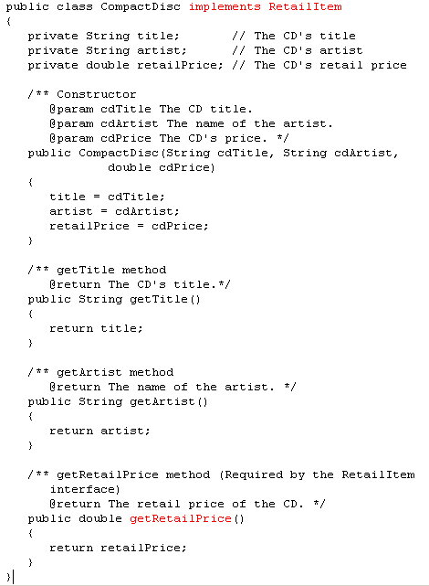
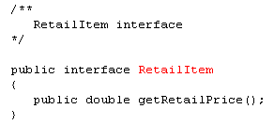

Slide 19
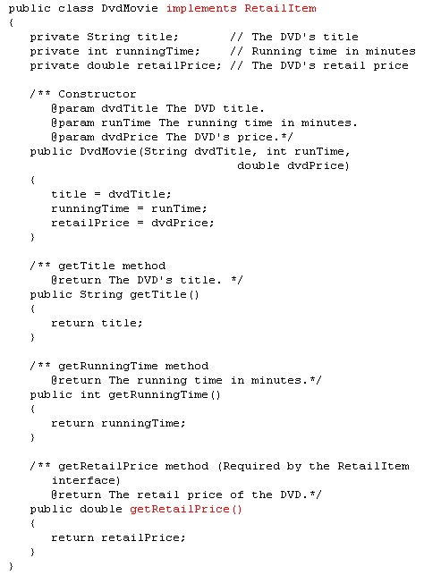

Slide 20
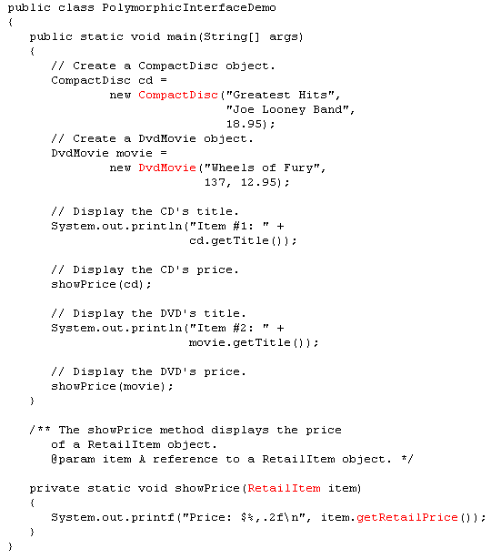
No, only getRetailPrice can be
Called from a RetailItem reference
Could I add this to the printf statement?
item.getTitle();

Slide 21
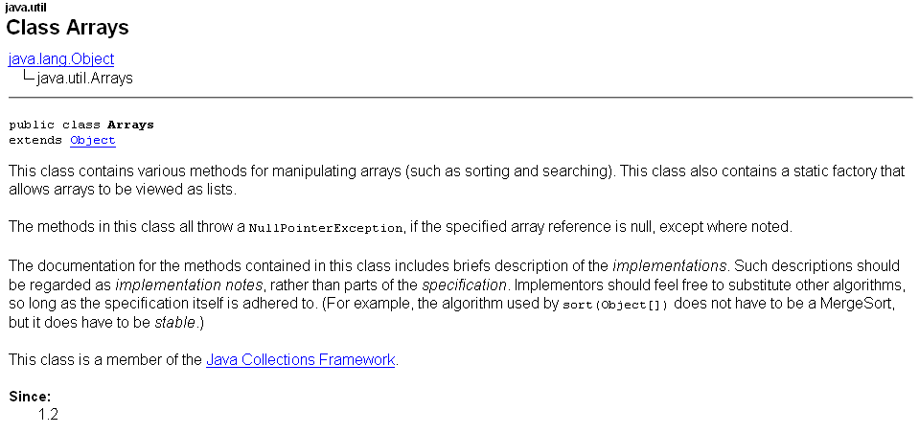
Using interfaces

Slide 22
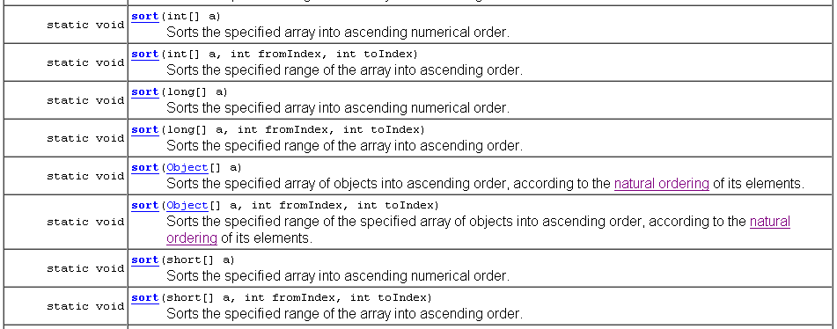
Using interfaces
What is natural ordering?

Slide 23
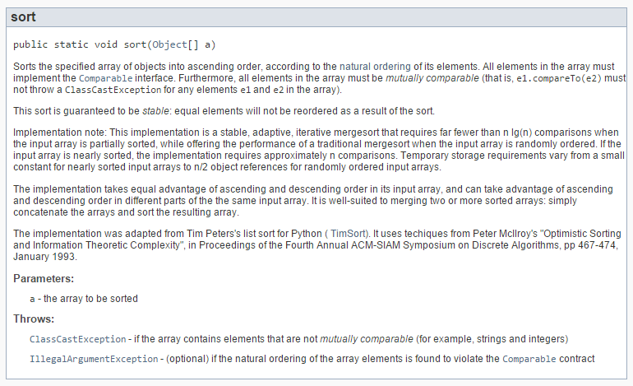

Slide 24
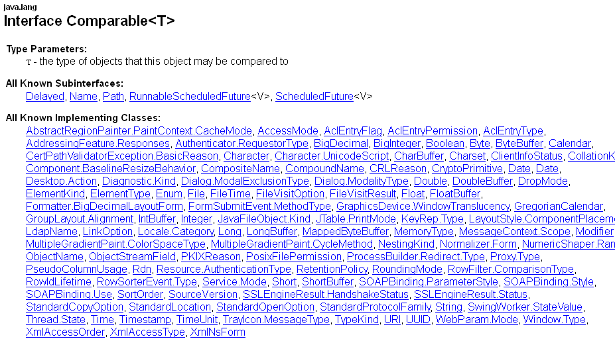
Comparable Interface

Slide 25
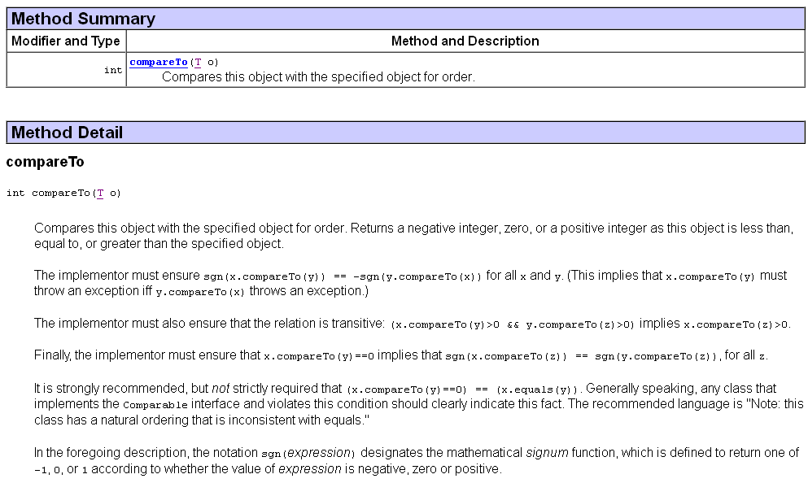

Slide 26
Suppose we want to sort an array of objects of the following class with the
Arrays.sort() method:
public class Student
{
private String firstName;
private String lastName;
private int age;
. . .
}
Implement the Comparable Interface
Give a body to the method compareTo()
What would need to be done?

Slide 27
public class Student implements Comparable
{
private String firstName;
private String lastName;
private int age;
. . .
public int compareTo(Student s)
{
if(lastName.compareTo(s.getLastName())==0)
if(firstName.compareTo(s.getFirstName()) ==0)
return 0;
else
return (firstName.compareTo(s.getFirstName()));
else
return (lastName.compareTo(s.getLastName()));
}
}
How would the following be sorted
John Smith
Fred Smythe
Janet Smith
Bob Smythe
Tom Smith
Janet Smith
John Smith
Tom Smith
Bob Smythe
Fred Smythe

Slide 28
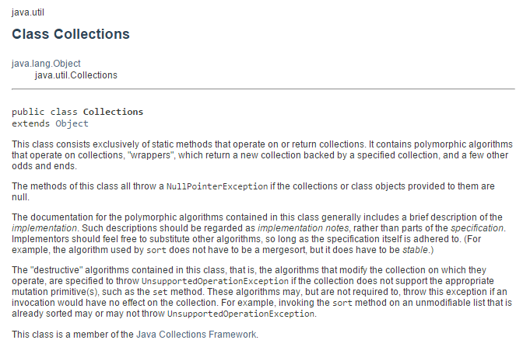
Using interfaces

Slide 29
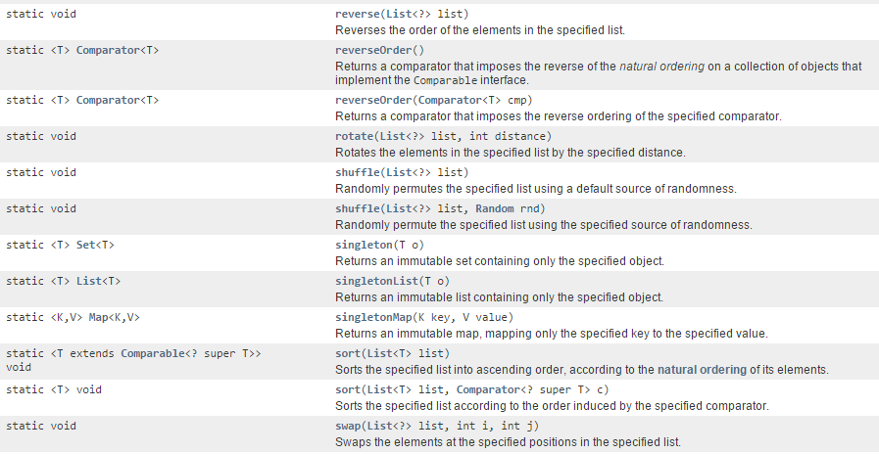
Using interfaces

Slide 30
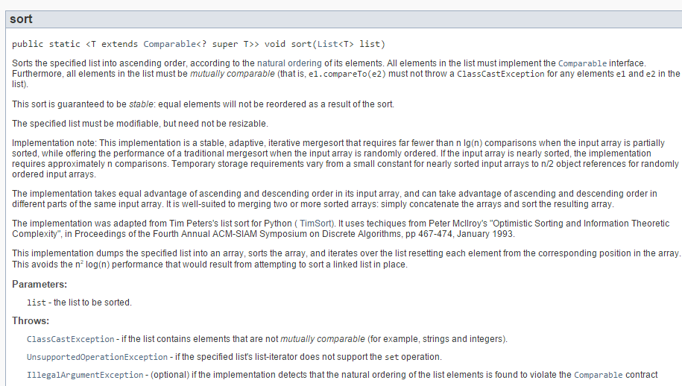

Slide 31
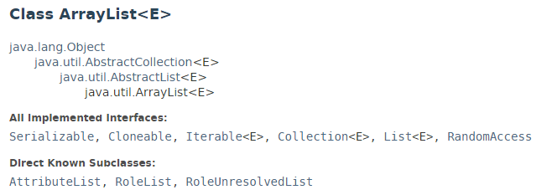
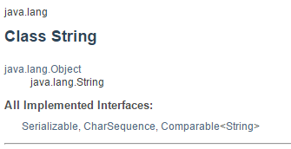
Using interfaces
ArrayList<String> implements List<E>, it is considered a List,
String implements Comparable<String>

Slide 32
ArrayList<String> can be sorted using this sort method from
The Collections class.
names = new ArrayList<String>();
names.add(name1);
names.add(name2);
public ArrayList<String> sortNames()
{
Collections.sort(names);
return names;
}

Slide 33
Suppose we want to sort an ArrayList of objects of the following class with the
Collections.sort() method:
public class Student
{
private String firstName;
private String lastName;
private int age;
. . .
}
Implement the Comparable Interface
Give a body to the method compareTo()
What would need to be done?

Slide 34
public class Student implements Comparable
{
private String firstName;
private String lastName;
private int age;
. . .
public int compareTo(Student s)
{
if(lastName.compareTo(s.getLastName())==0)
if(firstName.compareTo(s.getFirstName()) ==0)
return 0;
else
return (firstName.compareTo(s.getFirstName()));
else
return (lastName.compareTo(s.getLastName()));
}
}

Slide 35
Default Methods
Beginning in Java 8, interfaces may have default methods.
A default method is an interface method that has a body.
You can add new methods to an existing interface without causing errors in the classes that already implement the interface.
Example:
Displayable.java
Person.java
InterfaceDemoDefaultMethod.java

Slide 36

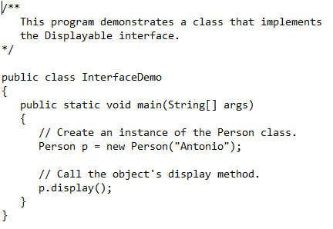
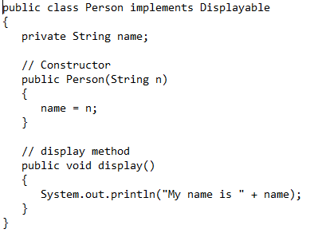
Example of interface without a default method

Slide 37
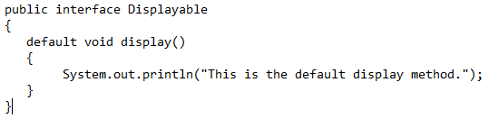
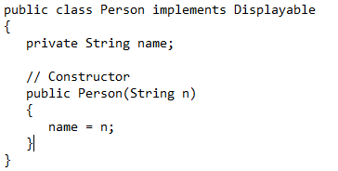
Example of interface with a default method

Slide 38
Anonymous Inner Classes
An inner class is a class that is defined inside another class.
An anonymous inner class is an inner class that has no name.
An anonymous inner class must implement an interface, or extend another class.
Useful when you need a class that is simple, and to be instantiated only once in your code.
Example:
IntCalculator.java
AnonymousClassDemo.java

Slide 39

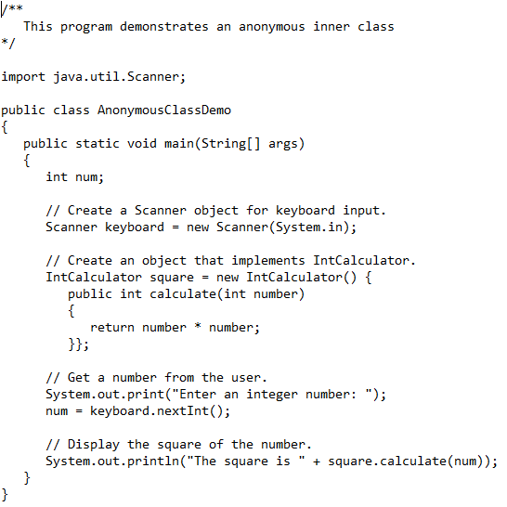
The anonymous class implements IntCalculator and gives a definition to the calculate method. The class has no name. square is the name of the object of this anonymous class.

Slide 40
Functional Interfaces and Lambda Expressions
A functional interface is an interface that has one abstract method.
A lambda expression can be used to create an object that implements the interface, and overrides its abstract method.
In Java 8, these features work together to simplify code, particularly in situations where you might use anonymous inner classes.
Example:
LambdaDemo.java
LambdaDemo2.java

Slide 41
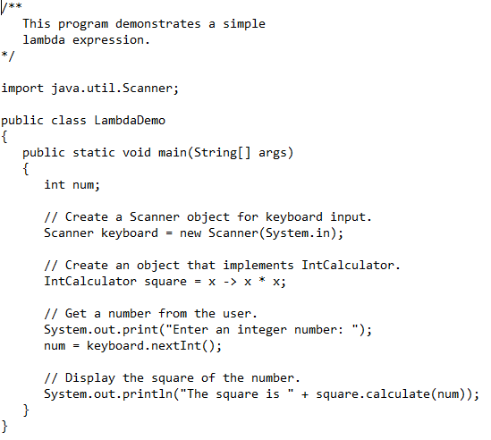

Means the same as

Slide 42
